Slide 1
The NERVOUS SYSTEM
Al-Farabi Kazakh National University
Higher School of Medicine

Slide 3
The classic tissues - epithelia, nerve, muscle, and connective tissue - are combined to make up the major organs that, taken together, form the organism known as the human body
DAVID T. MORAN J. CARTER ROWLEY, III
Associate Professor Departments of Cellular and Structural Biology and Otolaryngology University of Colorado School of Medicine Denver, Colorado

Slide 4
the cells and tissues of which we are made are intrinsically of great aesthetic beauty; for in their creation, form has followed function
DAVID T. MORAN J. CARTER ROWLEY, III
Associate Professor Departments of Cellular and Structural Biology and Otolaryngology University of Colorado School of Medicine Denver, Colorado

Slide 5
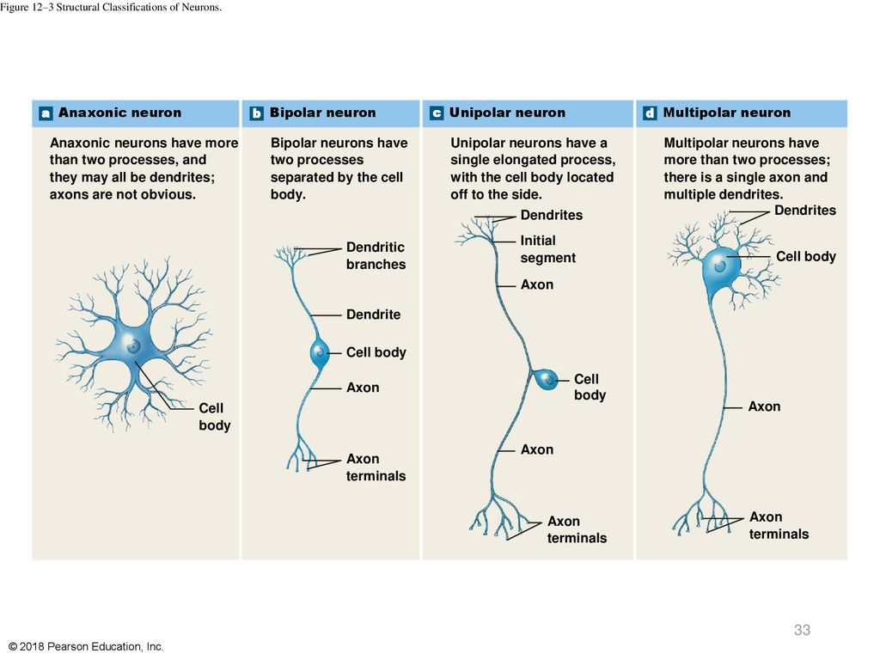

Slide 11
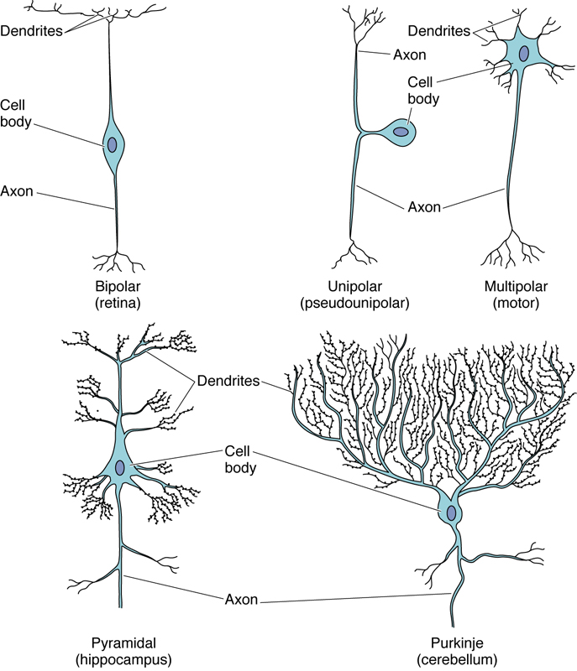

Slide 15
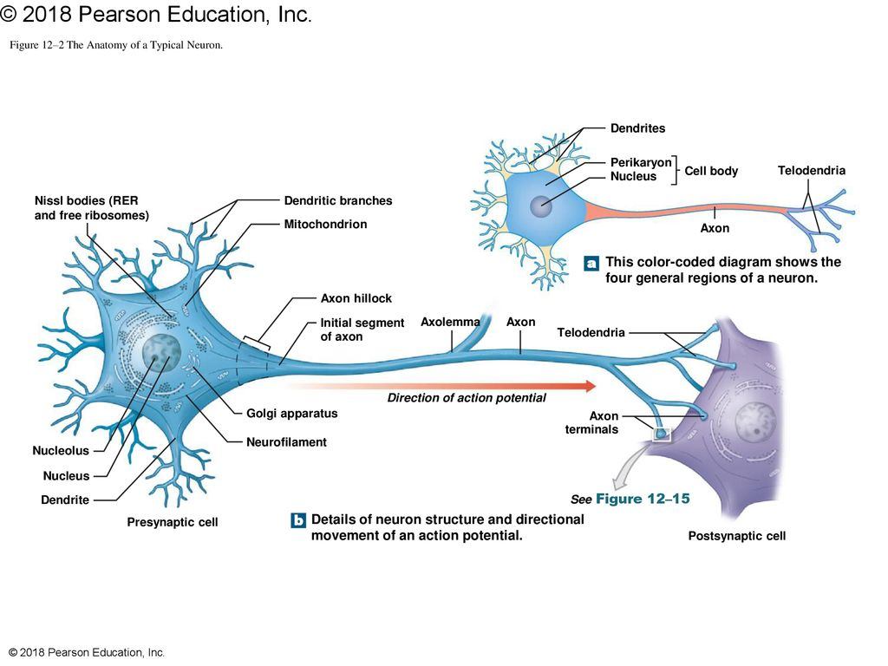

Slide 16
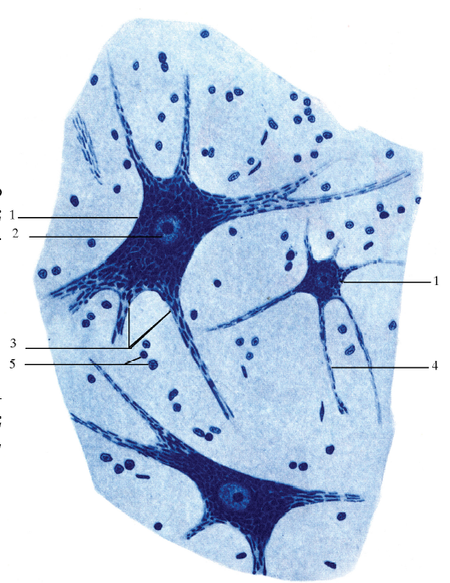
NISSL BODIES

Slide 17
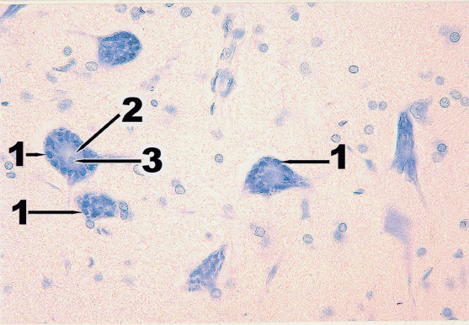

Slide 18
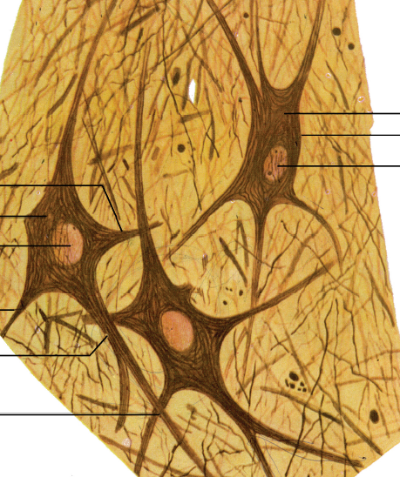
NEUROFILAMENTS

Slide 19
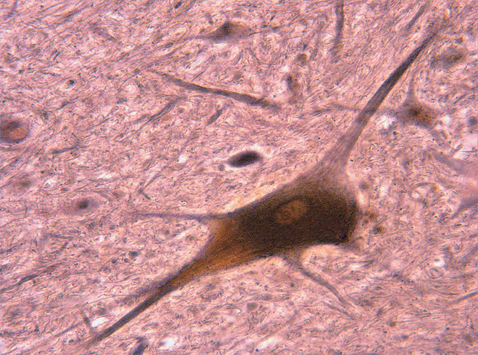

Slide 20
Supporting cells - NEUROGLIA

Slide 21
NEUROGLIA:
1. MACROGLIA
astrocytes
oligodendrocytes
ependymal cells
2. MICROGLIA

Slide 25
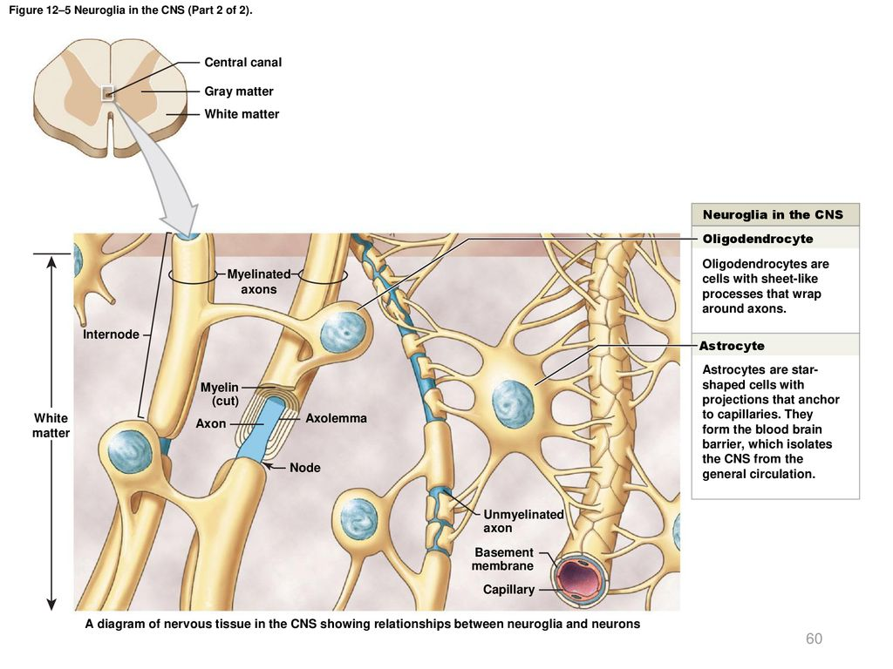

Slide 27
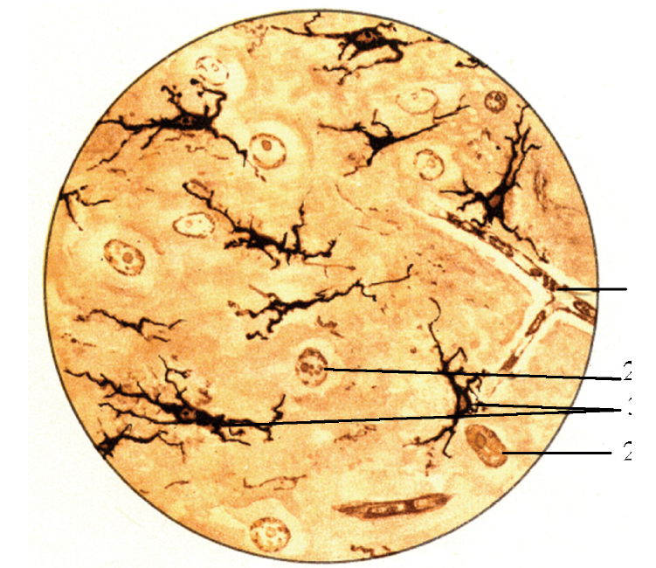

Slide 28
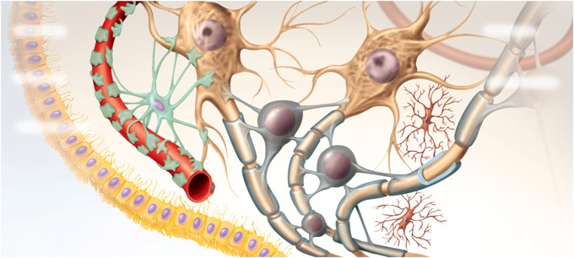

Slide 30
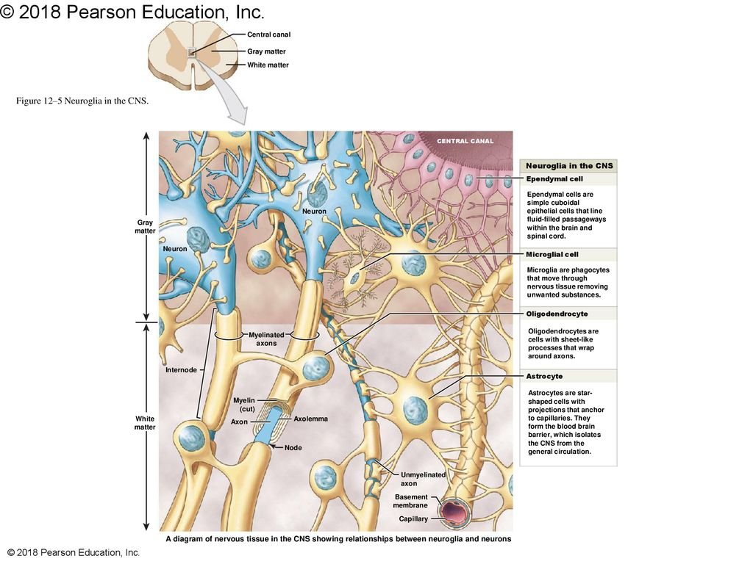

Slide 31
Nerve fibers
myelinated axons
unmyelinated axons

Slide 32
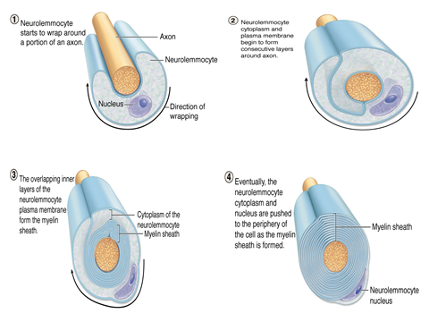
The nerve fibers

Slide 37
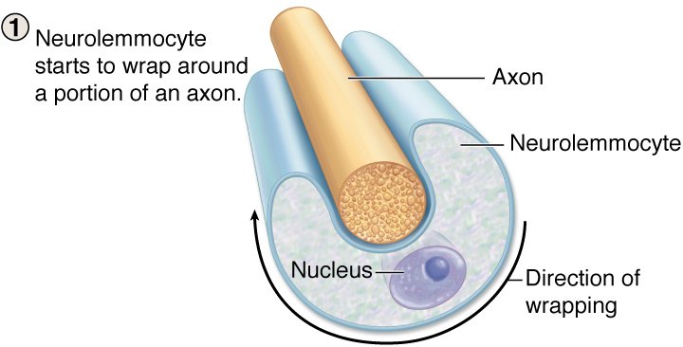
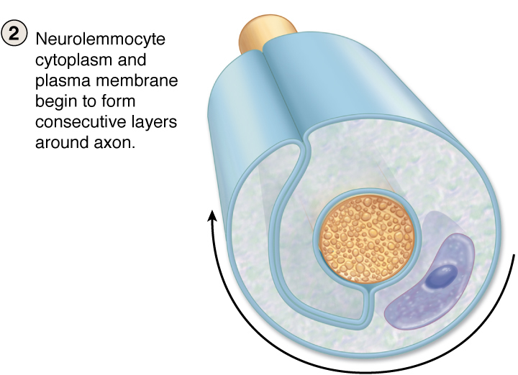
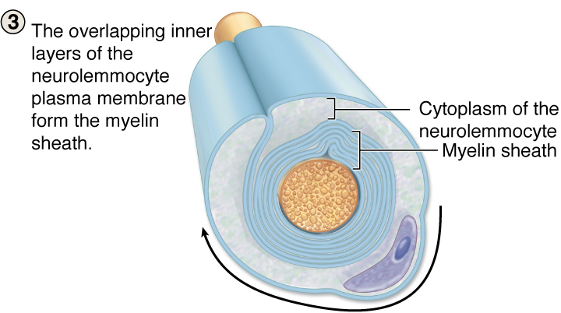
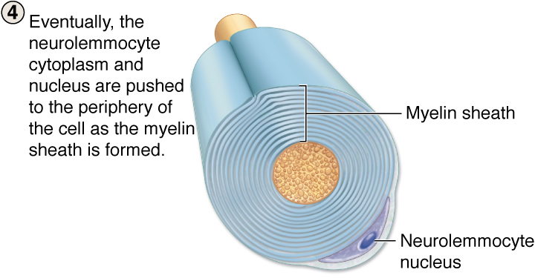

Slide 38
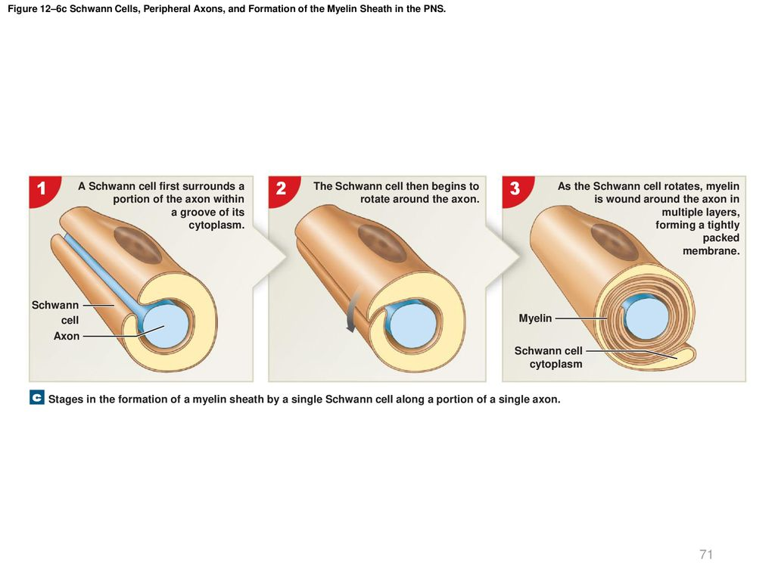

Slide 39
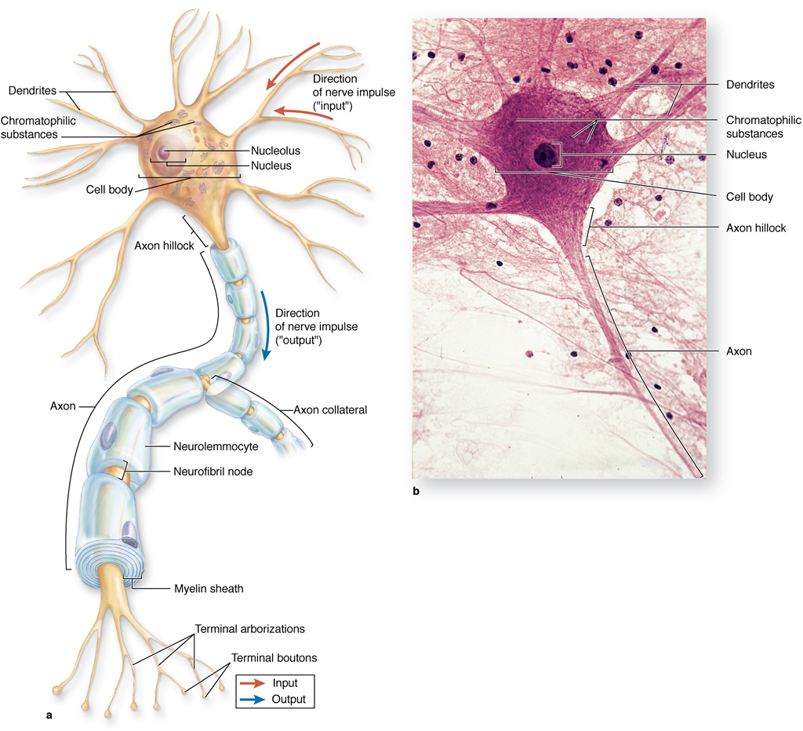

Slide 40
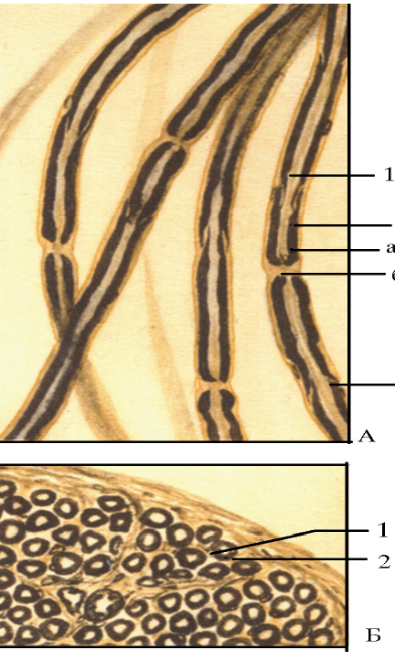

Slide 41
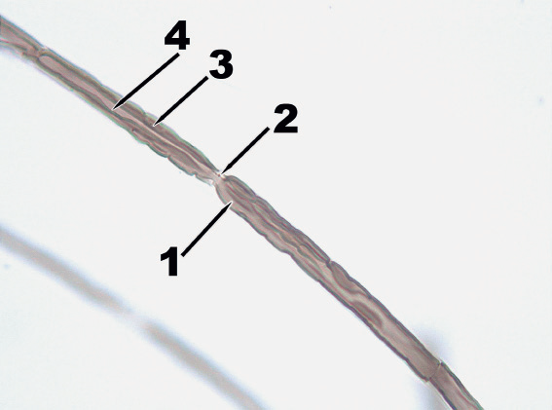

Slide 42
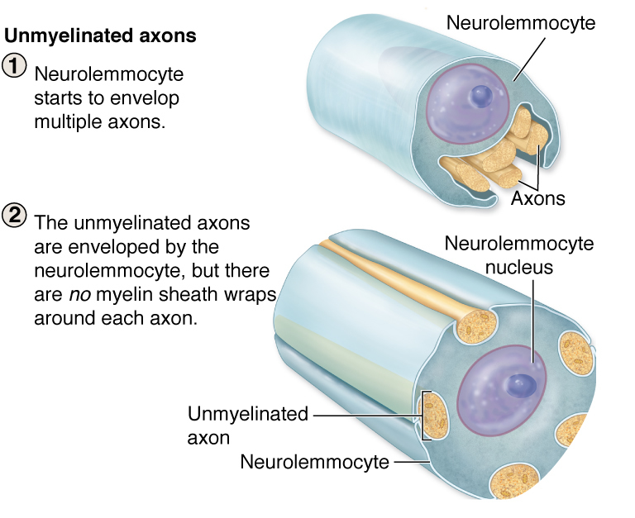
The nerve fibers

Slide 44
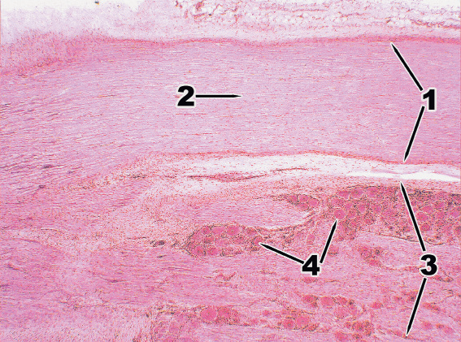

Slide 45
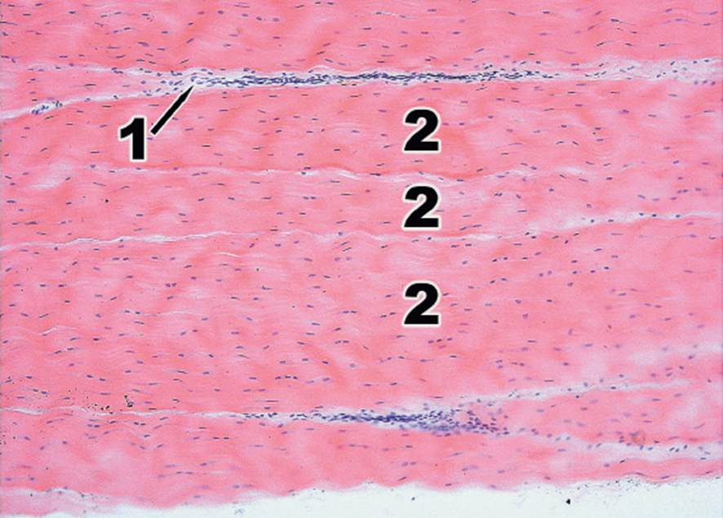

Slide 46
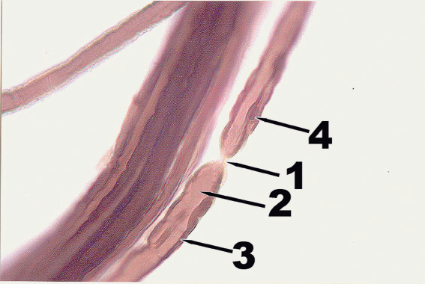

Slide 47
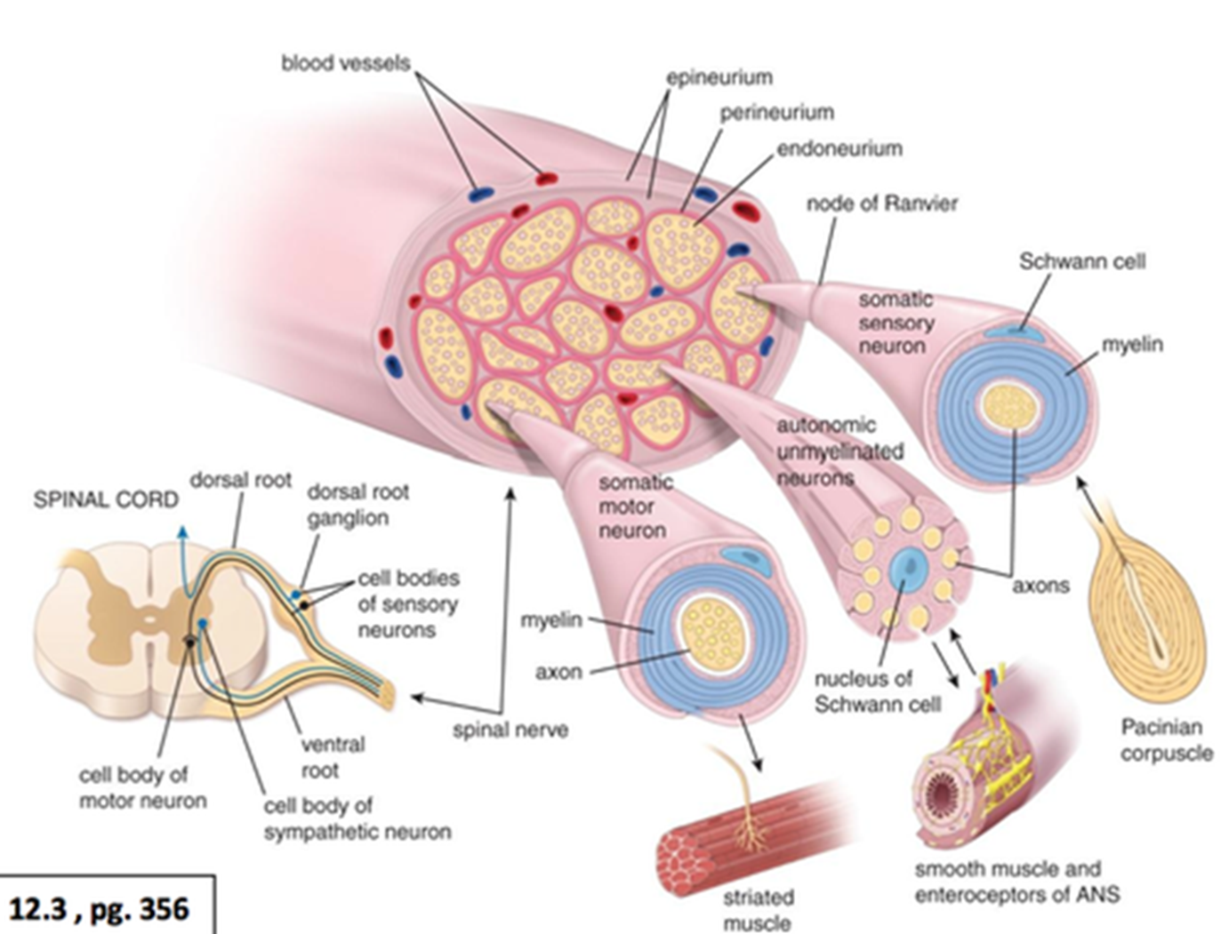
Nerve is a bundle of nerve fibers, myelinated or unmyelinated, held together by connective tissue

Slide 48
Most nerves are mixed, they contain processes of both sensory and motor neurons

Slide 49
№ Steps | Criteria of quality | Excellent* | Satisfactory ** | Required correction (passed) *** | Failed ****
1. | Student has properly identified the histological slide and has fully named an organ, and it’s staining. | 10 | 7,5 | 5,0 | 0
2. | Student has rightly listed the organ’s structure on the histological slide, which shown on it from #1to #5. | 10 | 7,5 | 5,0 | 0
3. | Student has described the organ’s structure on the histological slide, shown under #1: indicating major tissue type, from which structure is composed, describing cellular organization of this structure. | 10 | 7,5 | 5,0 | 0
4. | Student has described the organ’s structure on the histological slide, shown under #2: indicating major tissue type, from which structure is composed, describing cellular organization of this structure. | 10 | 7,5 | 5,0 | 0
5. | Student has described the organ’s structure on the histological slide, shown under #3: indicating major tissue type, from which structure is composed, describing cellular organization of this structure. | 10 | 7,5 | 5,0 | 0
6. | Student has described the organ’s structure on the histological slide, shown under #4: indicating major tissue type, from which structure is composed, describing cellular organization of this structure. | 10 | 7,5 | 5,0 | 0
7. | Student has described the organ’s structure on the histological slide, shown under #5: indicating major tissue type, from which structure is composed, describing cellular organization of this structure. | 10 | 7,5 | 5,0 | 0
8. | Student has listed the organ’s functional significances and its mechanisms. | 10 | 7,5 | 5,0 | 0
9. | Student has shown a knowledge of the histological terms | 10 | 7,5 | 5,0 | 0
10. | Student has shown the relationship between basic (knowledge of organ’s histology) and clinical sciences (clinical syndroms), (demonstrating knowledge of clinical histology significance). | 10 | 7,5 | 5,0 | 0
 | Total score | 100 | 75 | 50 | 0

Slide 50
Peripheral nerves are bundles of nerve fibers (axons) surrounded by several investments of connective tissue sheaths. These bundles (fascicles) may be observed with the unaided eye; those that are myelinated appear white because of the presence of myelin. Usually, each bundle of nerve fibers, regardless of size, has both sensory and motor components.
Connective tissue investments of peripheral nerves include the epineurium, perineurium, and endoneurium.
The epineurium is composed of dense, irregular, collagenous connective tissue.
Perineurium, the middle layer of connective tissue investments, covers each fascicle within the nerve. The perineurium is composed of dense connective tissue but is thinner than epineurium.
Endoneurium, the innermost layer of the three connective tissue investments of a nerve, surrounds individual nerve fibers (axons).

